Slide 1

DEEPFAKE DETECTION
Presented by : Bhaskar Student ID : 142302004 Program : M.Tech Data Science Supervisor : Dr. Mrinal Kanti Das

Slide 2
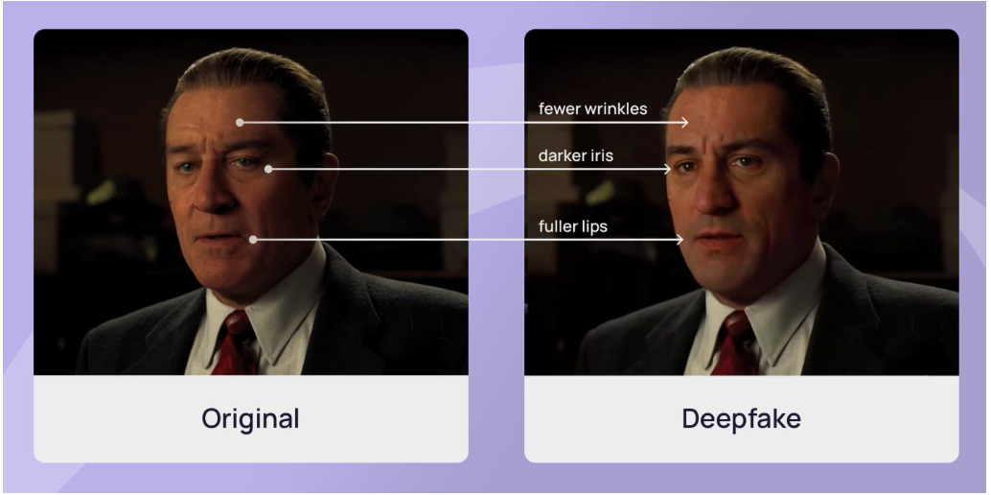
Problem STATEMENT
Deepfakes are AI-generated fake images or videos that can closely mimic real human faces. Detecting them is challenging, especially when only parts of the face are altered or when new manipulation methods are used

Slide 3
Motivation
As deepfakes become more realistic, they pose serious risks in areas like misinformation, identity fraud, and public trust. A simple, generalizable, and efficient detection method is essential to help protect individuals and systems from being misled by fake visual content.
For example, a fake video/Image of a political leader saying something controversial could spread false information and cause public unrest

Slide 4
LITERATURE SURVEY
Title: Unlocking the Hidden Potential of CLIP in Generalizable Deepfake Detection Authors: Andrii Yermakov, Jan Cech, Jiri Matas Affiliation: Visual Recognition Group, Czech Technical University, Prague
Title: Unmasking DeepFakes with Simple Features Authors: Ricard Durall, Margret Keuper, Franz-Josef Pfreundt, Janis Keuper Affiliations: Fraunhofer ITWM, University of Heidelberg, Offenburg University, etc

Slide 5
Unlocking The Hidden Potential Of Clip In Generalizable Deepfake Detection
Goal :
To develop a generalizable and efficient deepfake detection method by leveraging the pre-trained CLIP ViT-L/14 visual encoder, using parameter-efficient fine-tuning (PEFT) (especially LN-tuning) and simple regularization strategies — enabling robust detection of subtle, partially manipulated facial forgeries across diverse and unseen datasets with minimal model modification.

Slide 6
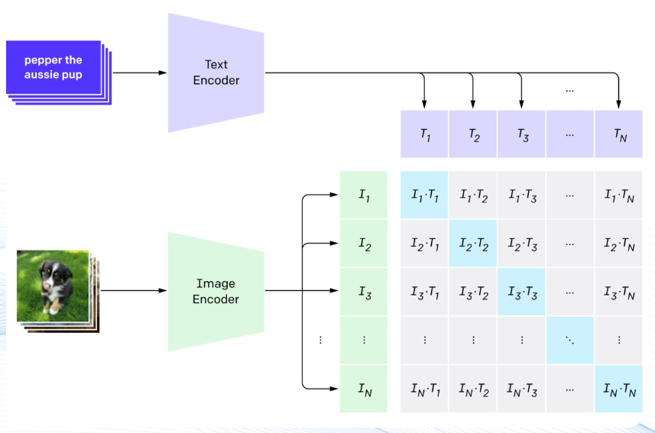

CLIP Architecture
In our deepfake detection setup, we are not utilizing the entire CLIP model. Instead, we focus exclusively on its image encoder, which is the vision transformer
(ViT-L/14).
We discard the text encoder and treat the vit image encoder as a powerful, pre-trained feature extractor, which we then adapt using parameter-efficient fine-tuning techniques (like ln-tuning) for detecting subtle facial manipulations

Slide 7
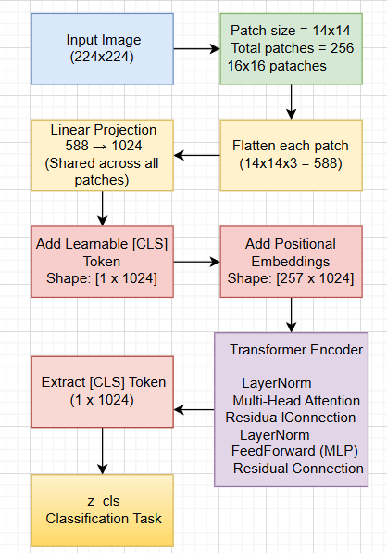
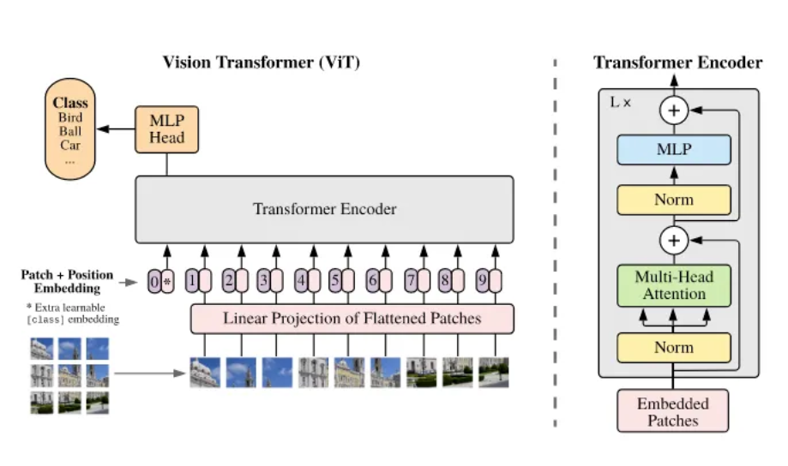
CLIP’s ViT-L/14 Architecture

Slide 8
Methods Used
Linear Probing
LN Tuning (LayerNorm Tuning)
LN Tuning + L2 Normalization
LN Tuning + L2 Normalization + SLERP-based Feature Augmentation

Slide 9
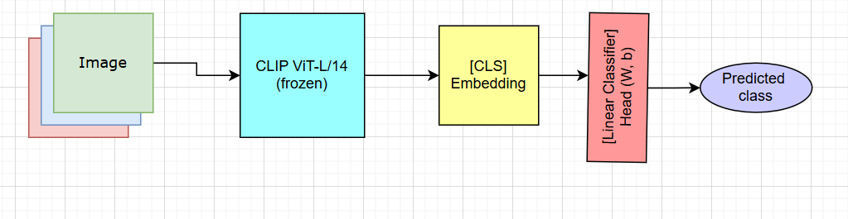
Linear probing
Linear probing is a technique used to evaluate the quality of pretrained representations (from CLIP) by freezing the entire backbone (ViT encoder) and training only a linear classifier (a single-layer MLP like nn.Linear) on top of the extracted features ([CLS] token embedding).
This sets the baseline performance for the rest of the paper.

Slide 10
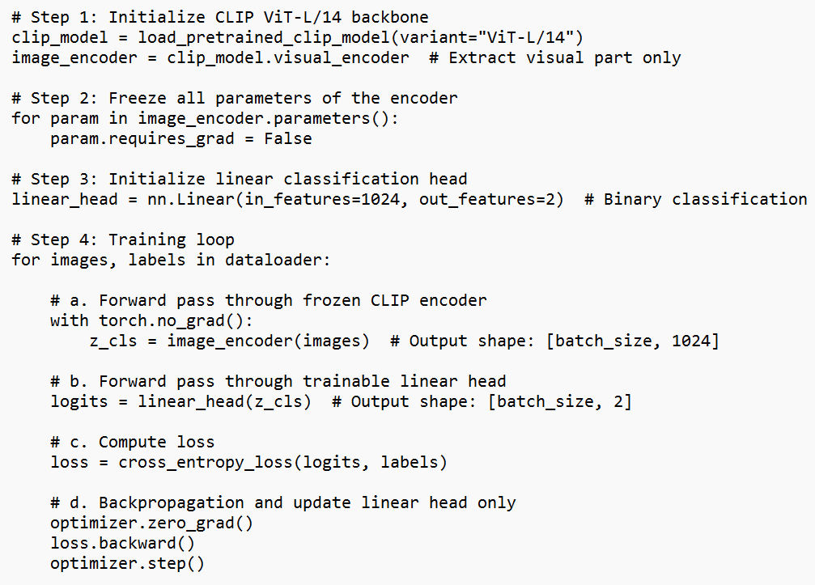

Linear Probing Pseudocode :
Total parameters: ~303M
Trainable: 2,050
Trainable %: ~0.0007%

Slide 11
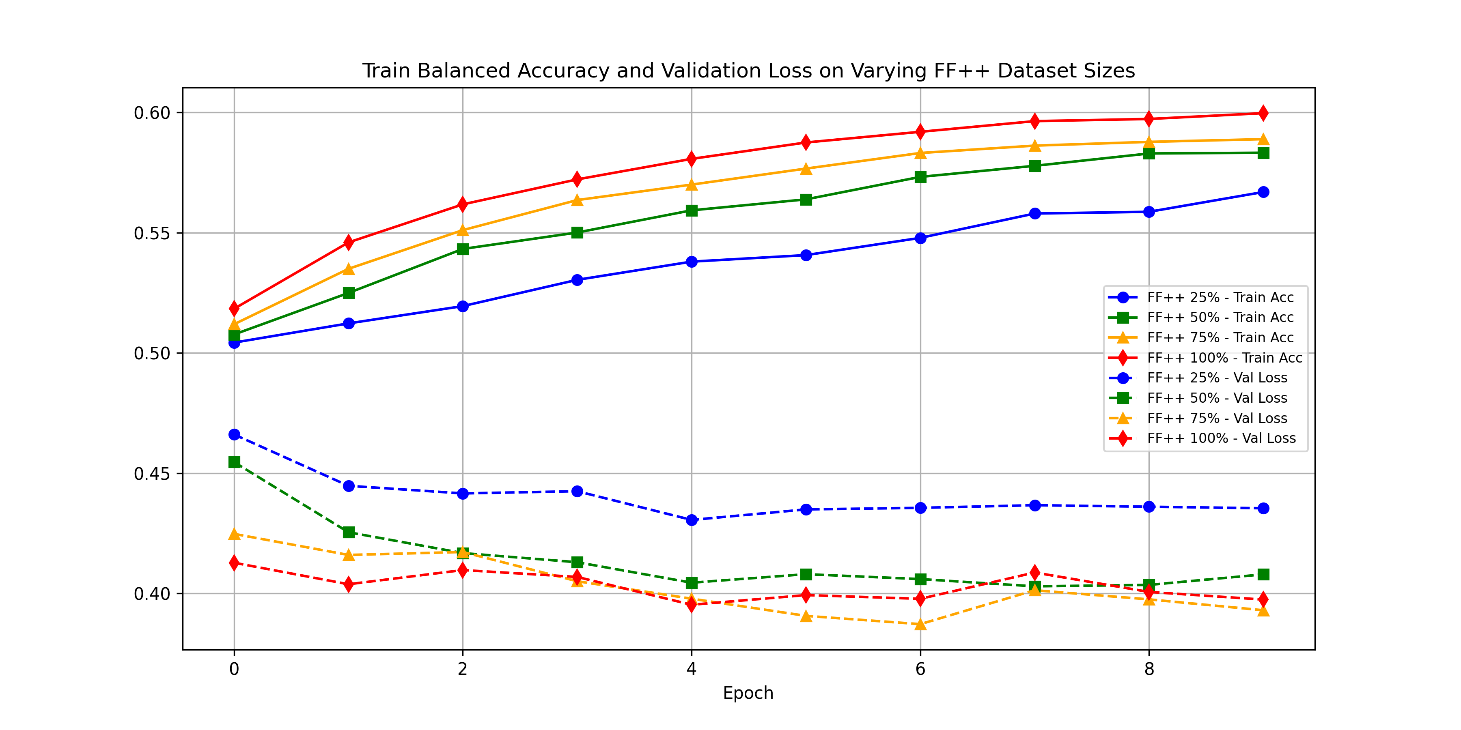
Results Across Varying Dataset Size of FF++ Dataset :

Slide 12
Observation
Positive Learning Trend: Both training balanced accuracy and validation loss consistently increased and decreased across all dataset sizes over the epochs, indicating good learning by the linear classifier.
Data Size Impact: Larger dataset sizes (100% > 75% > 50% > 25%) consistently resulted in higher training balanced accuracy and lower validation loss, demonstrating the clear benefit of more data.
All performance curves showed signs of plateauing by the later epochs (around epoch 8-9), suggesting the linear probe converged within the given training duration.
The ability of a simple linear classifier to achieve respectable performance (around 60% balanced accuracy) confirms that the frozen CLIP-ViT features are indeed linearly separable and carry meaningful discriminative information for the real vs. fake task.

Slide 13
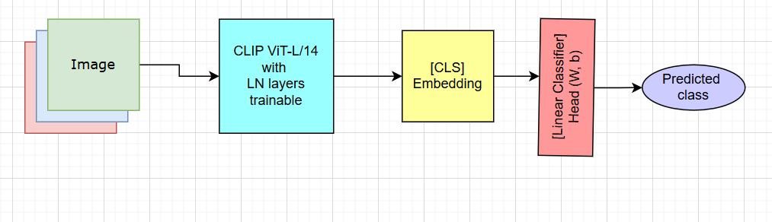
LN Tuning (LayerNorm Tuning)
LayerNorm (LN) Tuning is a parameter-efficient fine-tuning (PEFT) technique where only the LayerNorm parameters inside the frozen CLIP visual encoder (ViT-L/14) are made trainable, along with the classification head. This allows the model to adapt to the task with minimal changes, while preserving the bulk of the pretrained CLIP knowledge.

Slide 14
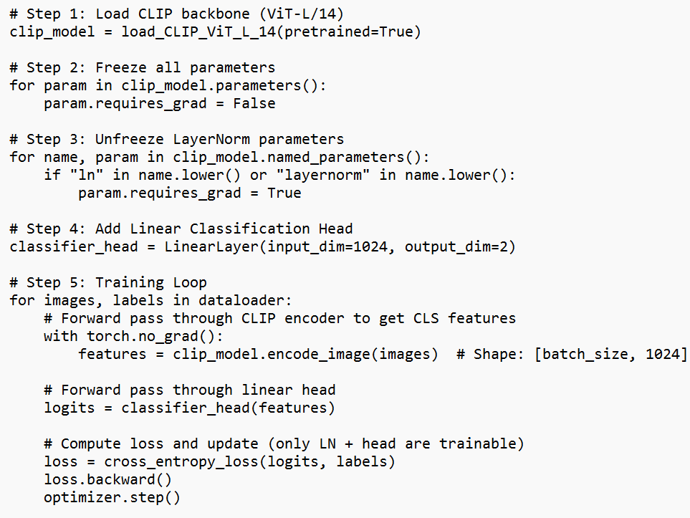


LN Tuning
Pseudocode :
Total parameters: ~303M
Trainable: ~104k
Trainable %: ~0.034%

Slide 15
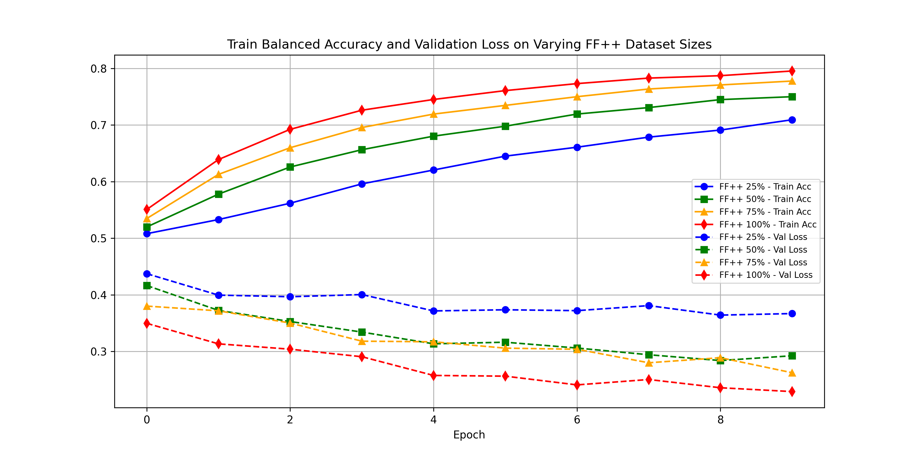
Results Across Varying Dataset Size :

Slide 16
Observation
Training Balanced Accuracy): All curves show a consistent upward trend, indicating learning. They range from approximately 0.52 at epoch 0 to between 0.70 and 0.80 by epoch 9.
Validation Loss All curves show a general downward trend, indicating improved generalization. They start between approximately 0.35 and 0.45 and drop to between 0.23 and 0.30 by epoch 9.
Balanced Accuracy: For 100% data, Linear Probing reached ~0.60 balanced accuracy. LayerNorm Tuning reaches ~0.80 balanced accuracy (a remarkable 20 percentage point improvement). Similar, though slightly smaller, improvements are seen across all dataset sizes.
Validation Loss: Linear Probing's lowest validation loss was slightly below 0.40. LayerNorm Tuning achieves a lowest validation loss of ~0.23 (a significant reduction).

Slide 17
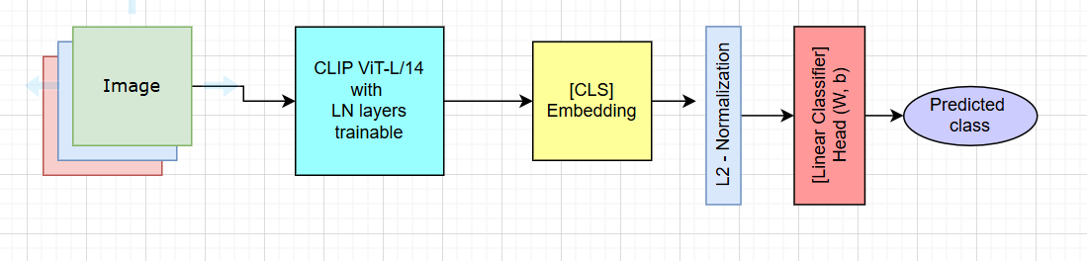
LN Tuning (LayerNorm Tuning) + Norm
This method extends LN-Tuning by applying L2 normalization to the [CLS] token features (z_cls) extracted from the CLIP encoder before passing them to the linear classifier. By constraining the features to lie on the unit hypersphere, it improves class separability, stability, and generalization

Slide 18
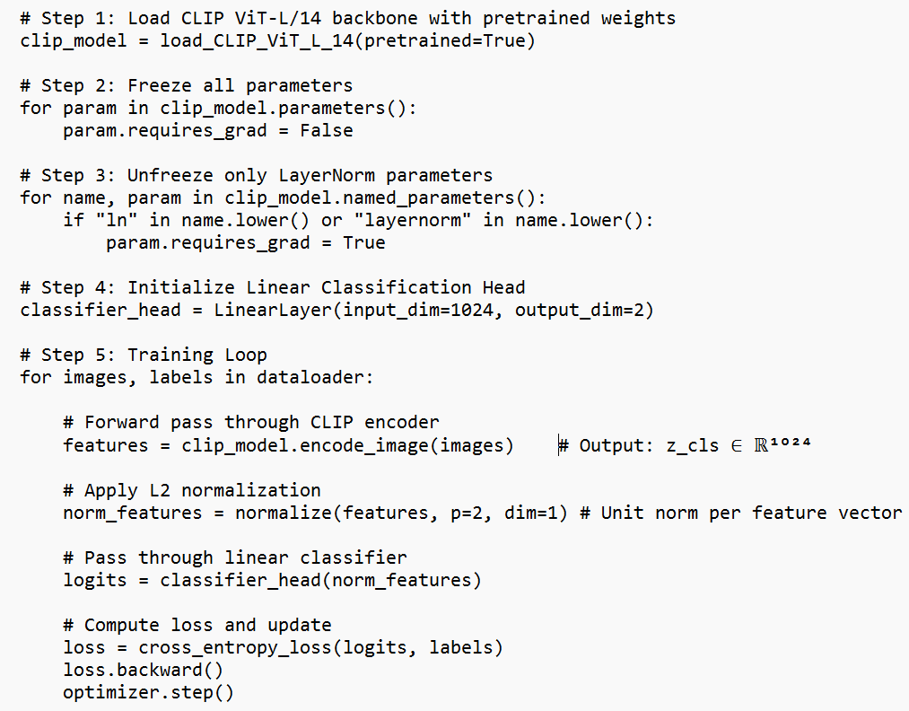
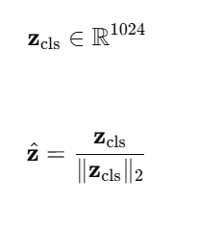
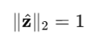


LN Tuning + Norm
Pseudocode :
Total parameters: ~303M
Trainable: ~104k
Trainable %: ~0.034%

Slide 19
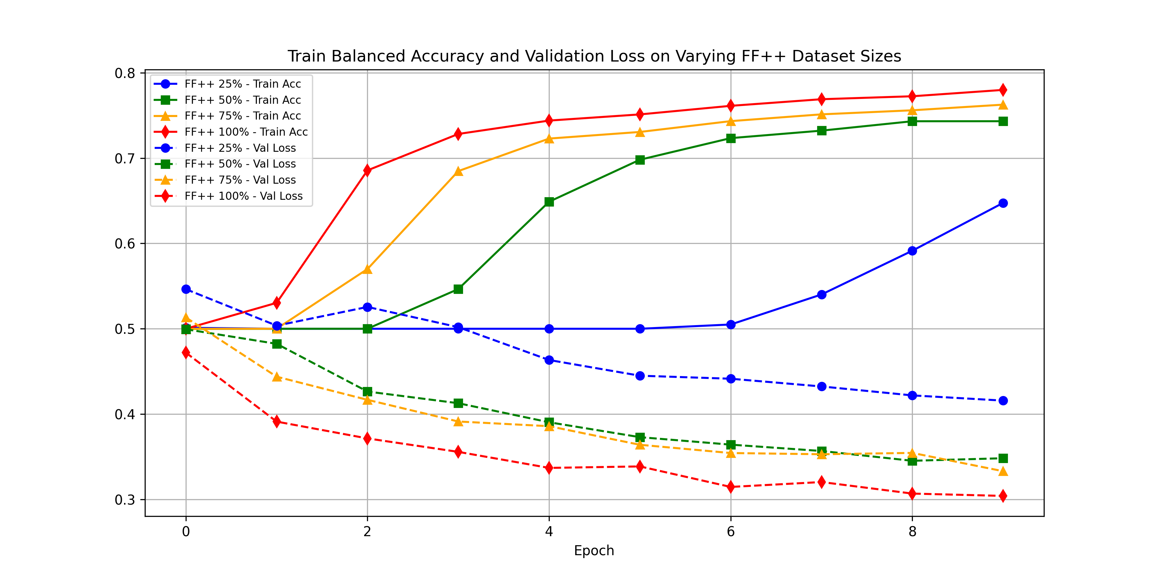
Results Across Varying Dataset Size :

Slide 20
Observation
Accelerated Initial Learning for Abundant Data: With 75% and 100% data, Method 3 exhibits a very steep and rapid increase in training accuracy and a sharp decrease in validation loss during the early epochs, indicating efficient and fast convergence when data is plentiful.
Delayed but Strong Learning for Limited Data: For the 25% dataset, there's a distinct pattern of initially slow learning (flat accuracy/loss for first few epochs) followed by a sudden and significant acceleration from epoch 4 onwards. This indicates that while L2 normalization might require more time to optimize with sparse data, it ultimately helps achieve superior results.
Adding LayerNorm tuning and L2 normalization makes the pre-trained features far more effective and adaptable for the task than just using them as-is with a linear classifier.

Slide 21
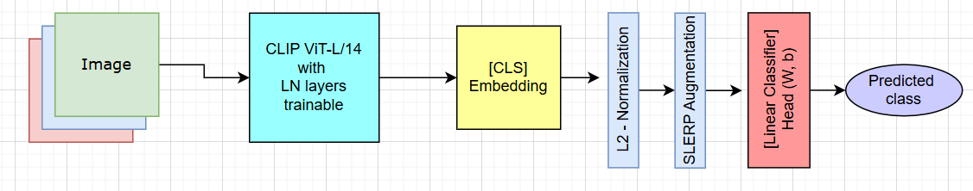
LN Tuning (LayerNorm Tuning) + Norm + SLERP
This method builds upon LN-Tuning + L2 Normalization by introducing latent space augmentation via Spherical Linear Interpolation (SLERP).It augments the training data by interpolating between normalized feature embeddings (z_cls) of samples belonging to the same class, encouraging the model to learn more robust decision boundaries and generalize better to unseen manipulations.

Slide 22
Working of SLERP Augmentation & loss Computation
For simplicity, using 2D embeddings instead of 1024D.
Step 1: CLS Token Extraction (assume we got)
Image | CLS Token (zᵢ) | Class
I₁ | z₁ = [2.0, 3.0] | 0
I₂ | z₂ = [0.92, 0.38] | 0
I₃ | z₃ = [0.4, 0.9] | 1
I₄ | z₄ = [-1.2, 3.2] | 1
Image | CLS Token (zᵢ) | Class
I₁ | z₁ = [1.0, 0.0] | 0
I₂ | z₂ = [0.92, 0.38] | 0
I₃ | z₃ = [0.0, 1.0] | 1
I₄ | z₄ = [-1.0, 0.0] | 1
Step 2: L2 Normalization
Ensures all vectors lie on the unit hypersphere (‖z‖ = 1).

Slide 23
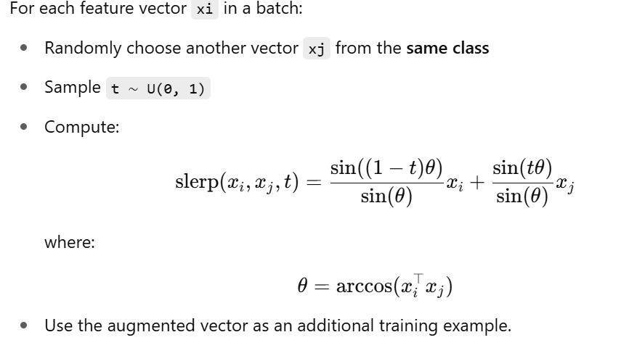
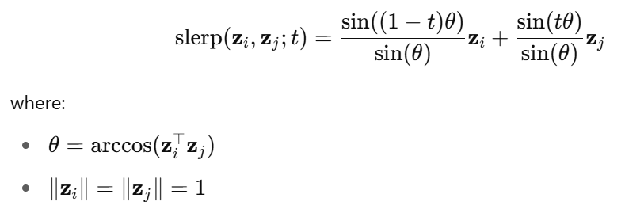
Step 3: SLERP Augmentation
zᵢ |  | True Label
z₁ | [1.0, 0.0] | 0
z₂ | [0.92,0.38] | 0
z₃ | [0.0,1.0] | 1
z₄ | [-1.0, 1.0] | 1
z₅ | [0.93, 0.50] | 1 (interpolated fake)

Slide 24
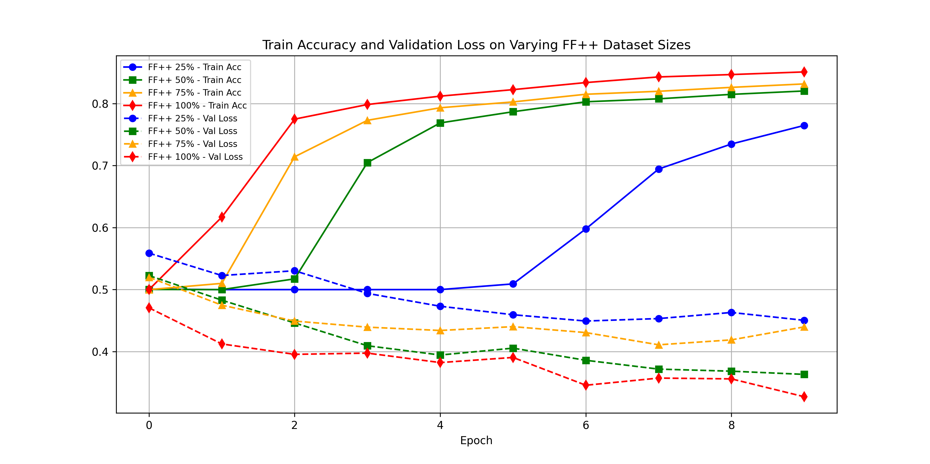
Results Across Varying Dataset Size :

Slide 25
Observation
Highest Overall Performance: This method consistently achieves the highest balanced accuracy across most dataset sizes, peaking at ~0.85 for 100% data. This marks a substantial improvement over all prior methods, demonstrating its superior ability to extract and classify features.
Exceptional Gains for Limited Data: The most striking result is the dramatic improvement for the 25% dataset, where accuracy surges from ~0.55 (Method 2) or ~0.65 (Method 3) to ~0.76. This highlights Slerp's effectiveness in compensating for data scarcity by synthesizing meaningful latent-space variations.
For smaller datasets (25%), the training exhibits a pronounced initial lag (slow learning for first few epochs) followed by a sudden and significant acceleration in performance. This suggests Slerp's full benefits become apparent once sufficient initial feature understanding is established.
Accelerated Initial Learning for Abundant Data: Conversely, with ample data (75% and 100%), the model demonstrates extremely rapid learning from epoch 0, quickly achieving high accuracy. This indicates the potent combination of Slerp augmentation and the multi-objective loss function (Cross-Entropy + Alignment + Uniformity) efficiently guides the feature space organization.

Slide 26
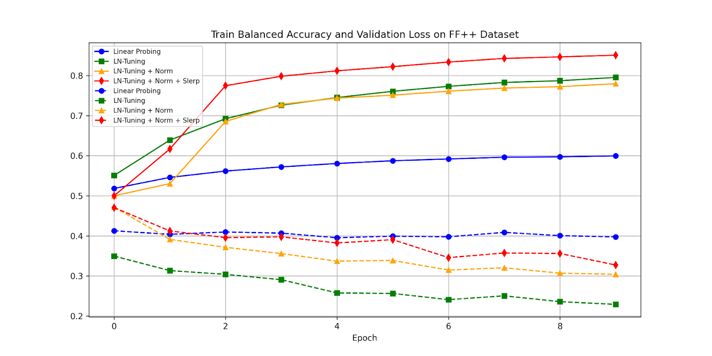
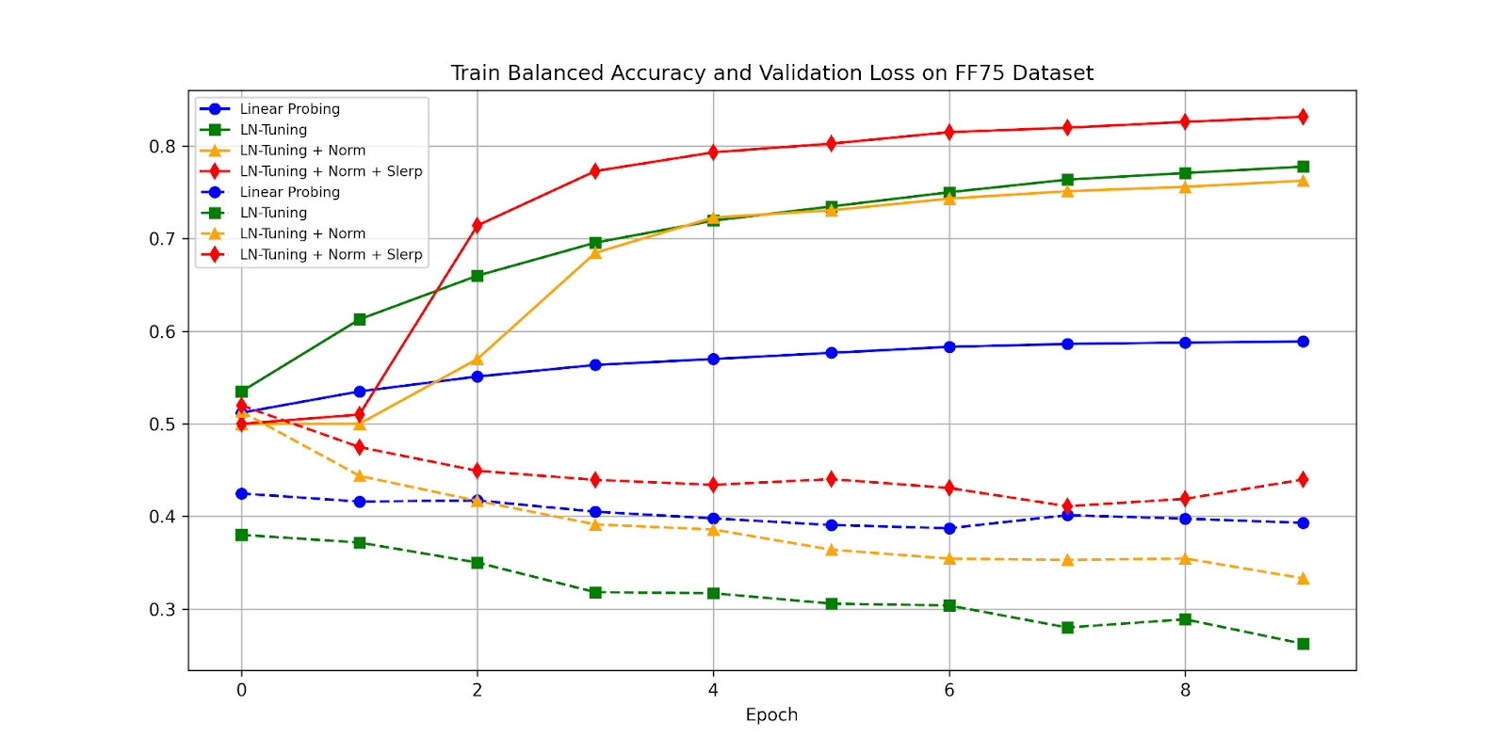
Comparing Methods Across Varying Dataset Size - I

Slide 27
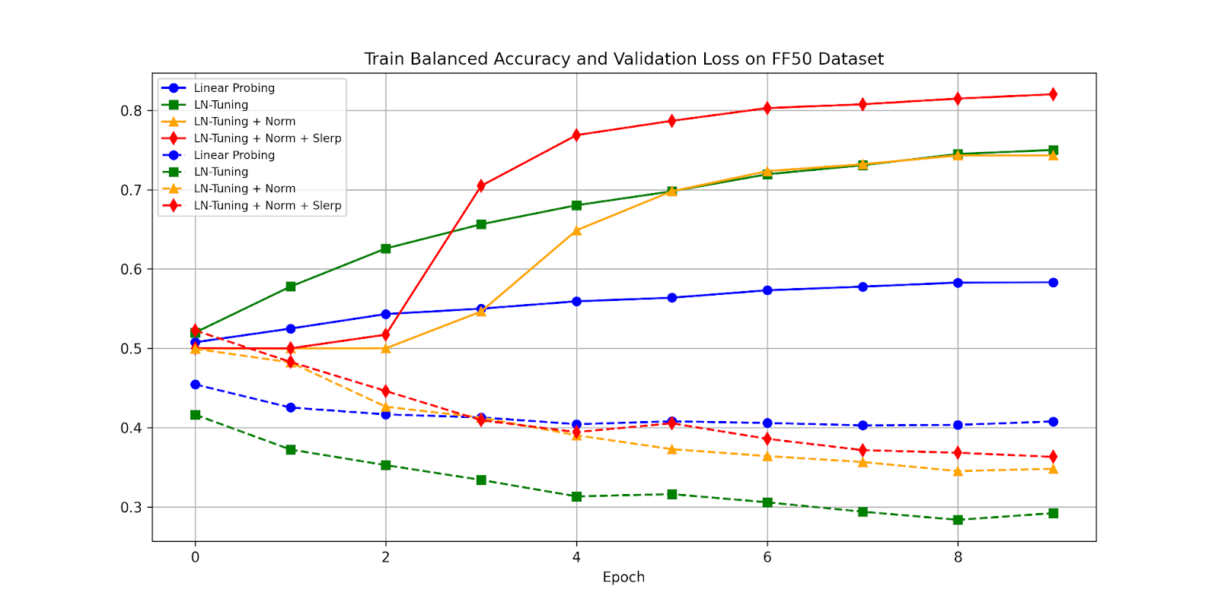
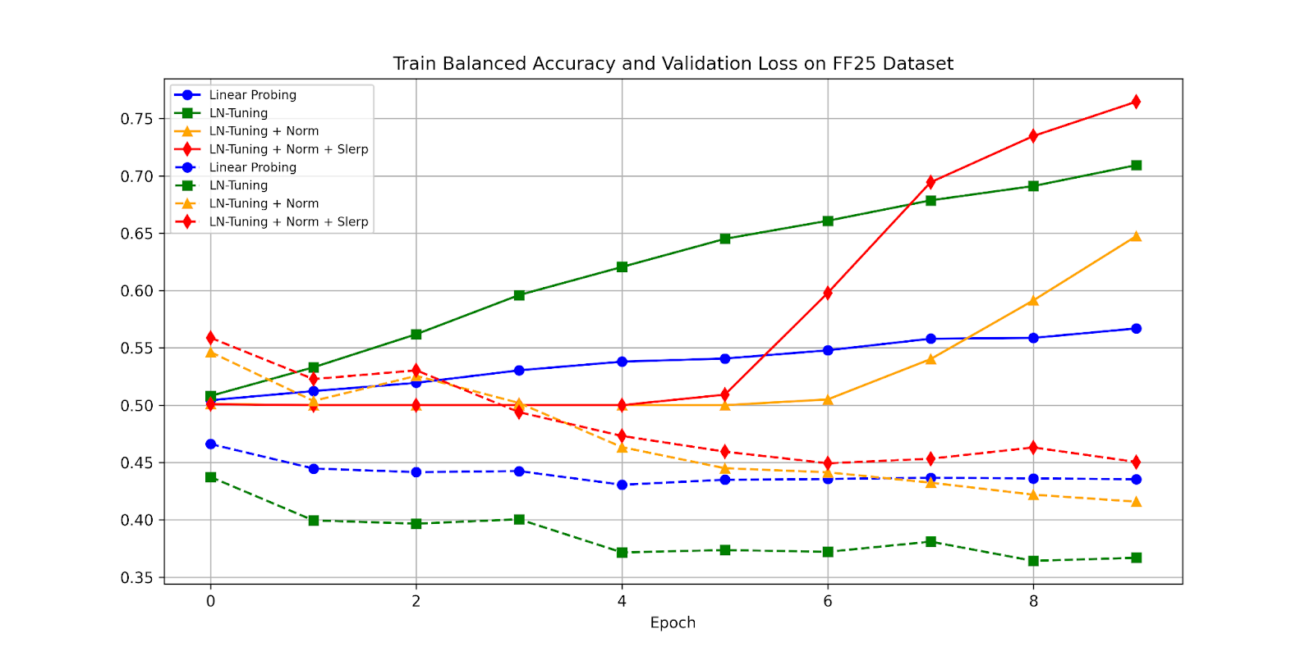
Comparing Methods Across Varying Dataset Size - II

Slide 28
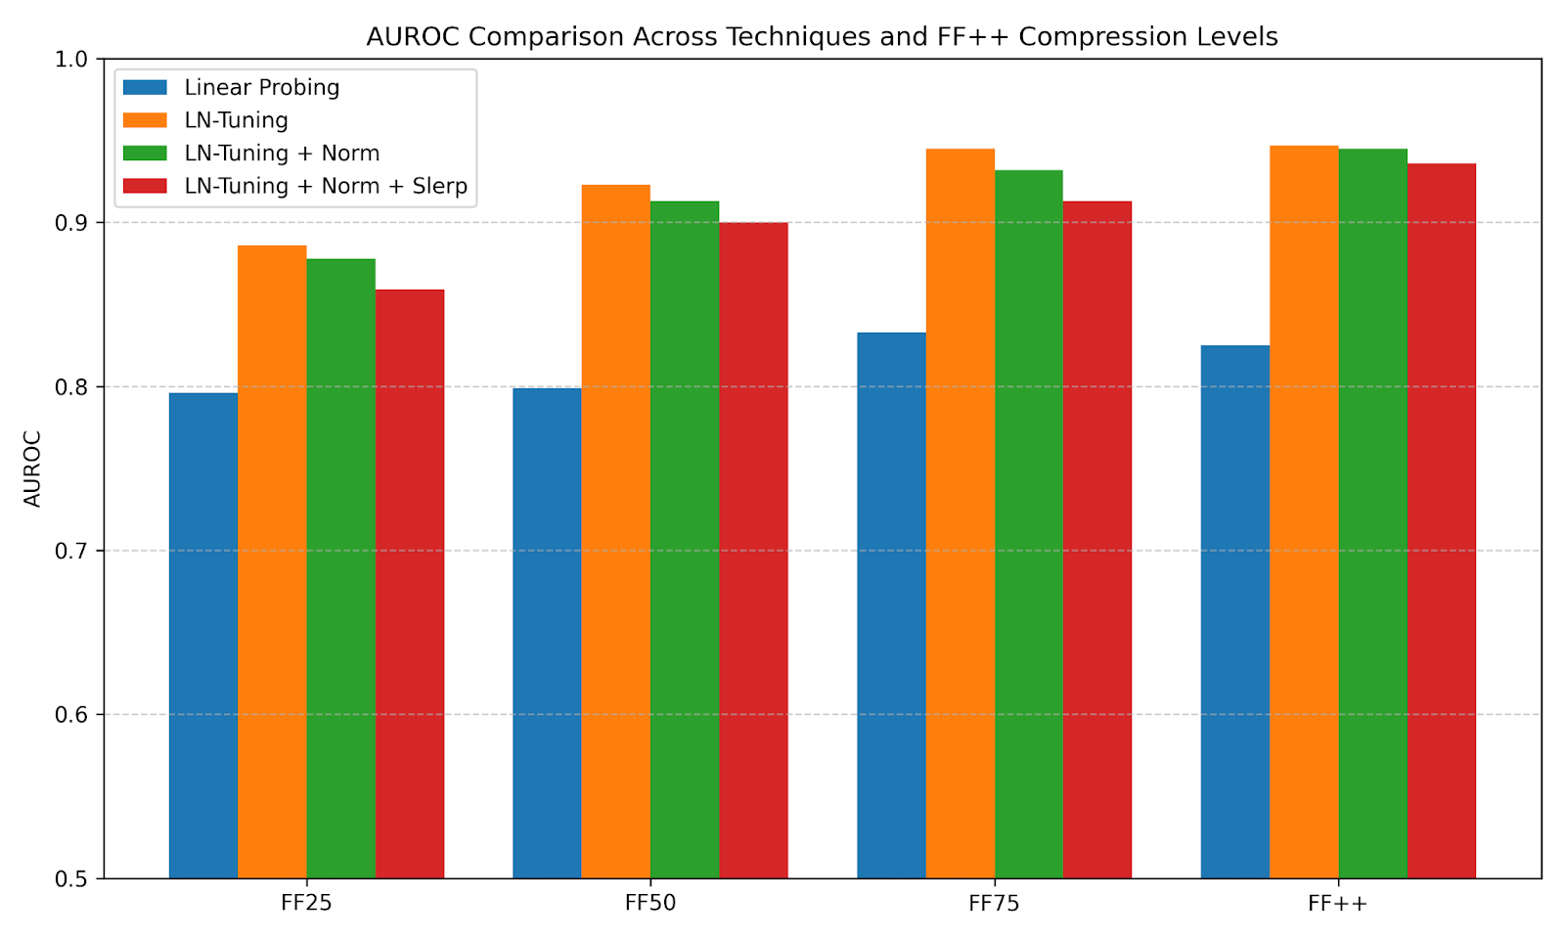
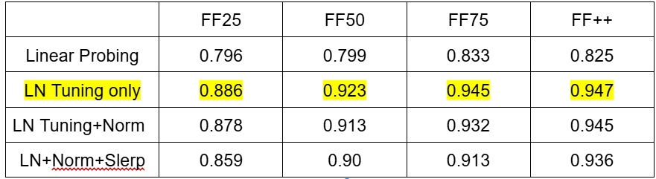
AUROC Comparison Across Methods On Varying Dataset Size

Slide 29
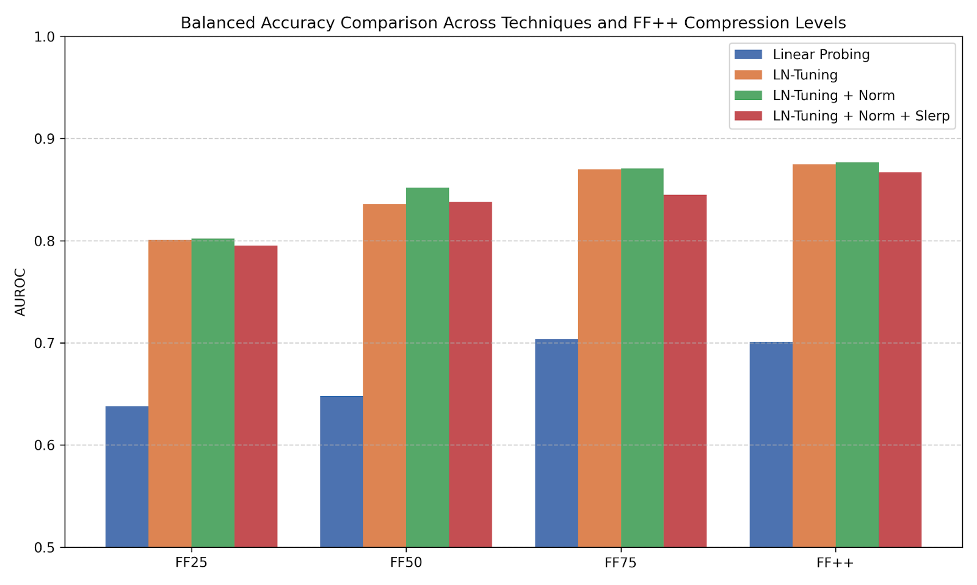
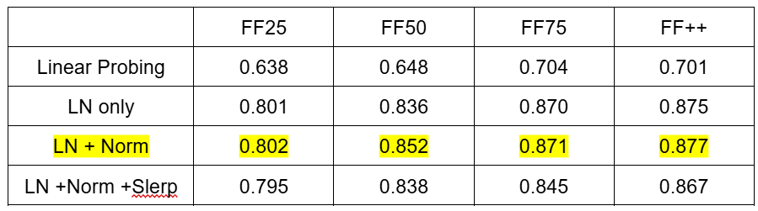
Balanced Accuracy Comparison Across Methods On Varying Dataset Size
Balanced Accuracy

Slide 30
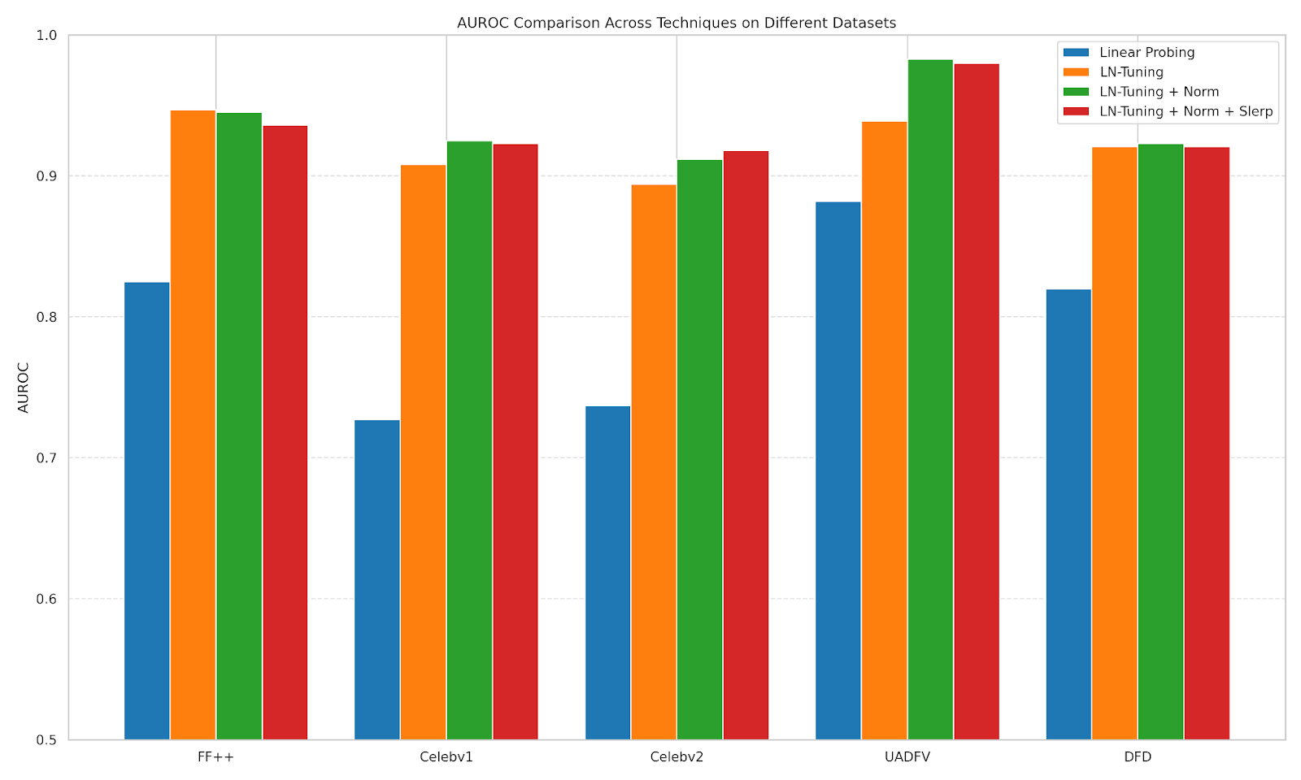
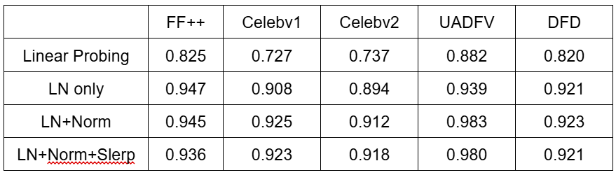
Cross-Dataset Evaluation
AUROC Comparison Across Methods on Different Dataset

Slide 31
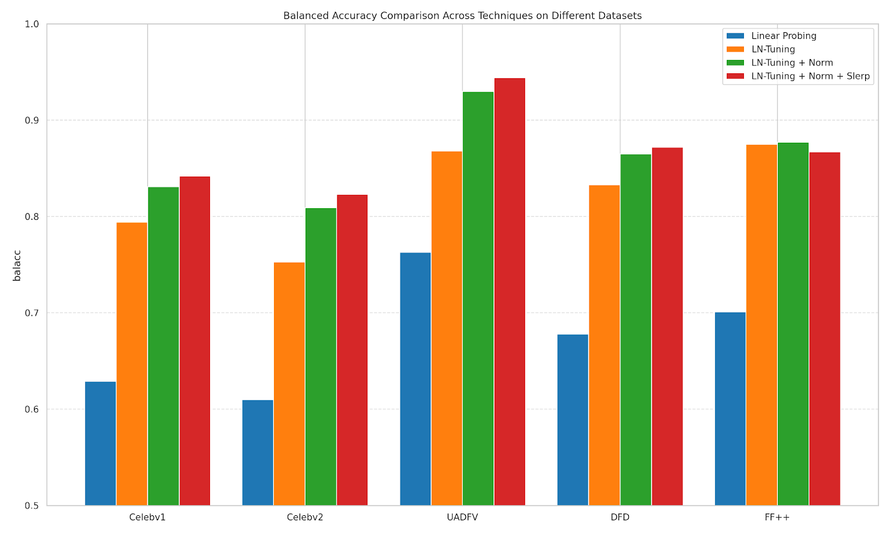
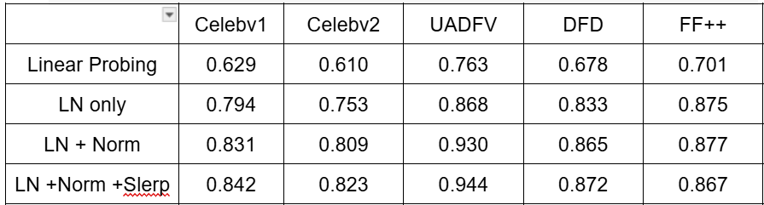
Cross-Dataset Evaluation
Balanced Accuracy Comparison Across Methods on Different Datasets

Slide 32
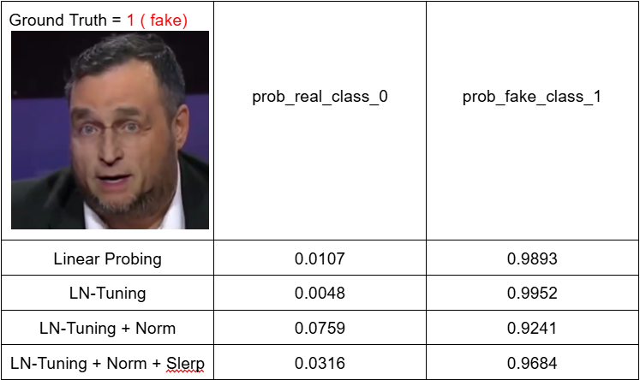
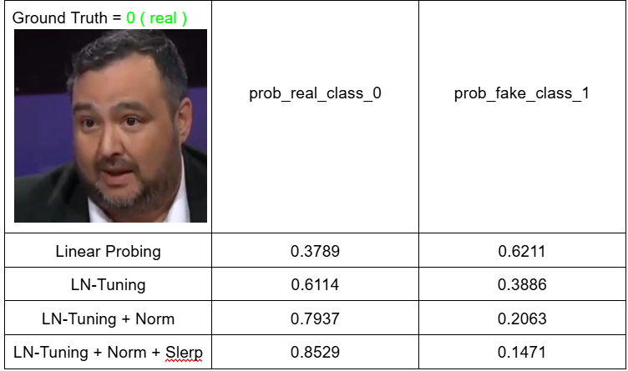
Sample Test Image Taken From FF++ Dataset !

Slide 33
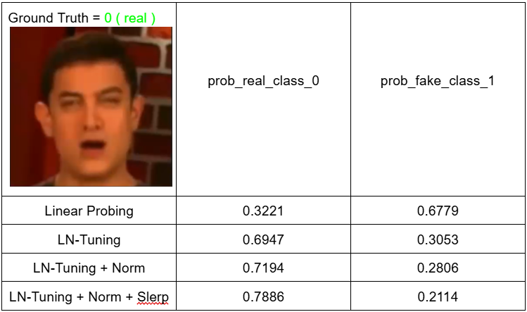
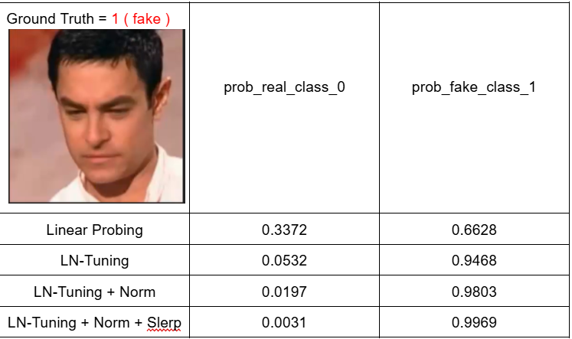
Sample Test Image Taken From Celebv1 Dataset !

Slide 34
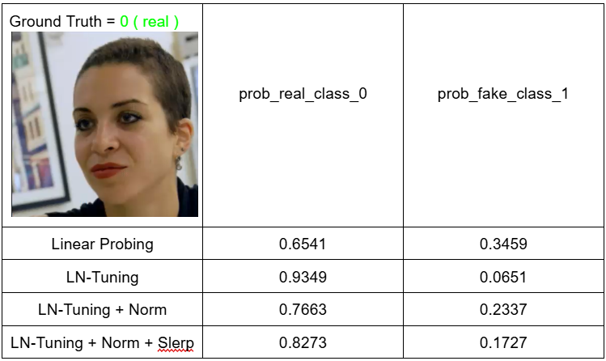
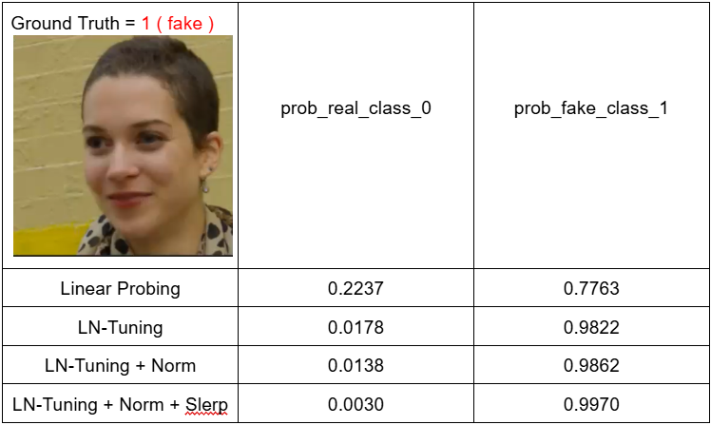
Sample Test Image Taken From DFD Dataset !

Slide 35
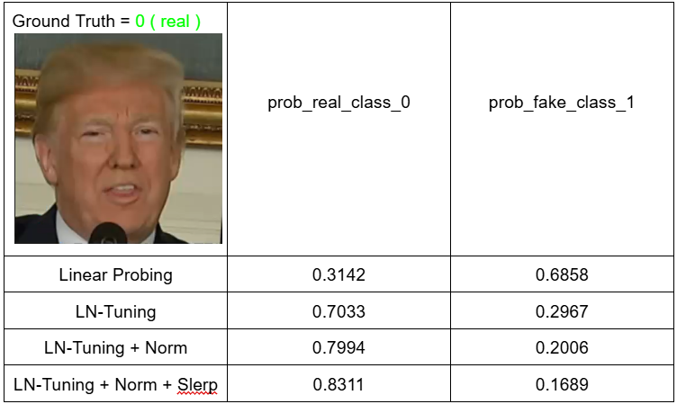

Sample Test Image Taken From UADFV Dataset !

